Slide 1

MAHATMA GANDHI INSTITUTE OF TECHNOLOGY (A) DEPARTMENT OF INFORMATION TECHNOLOGY
Industrial Oriented Mini Project (IT653PC)
On
AI-POWERED PLANT DISEASE PREDICTION SYSTEM
By
Vedant Malpani(22261A1262)
Priteesh Reddy(22261A1245)
Batch ID: IT 25-02
Internal Supervisor IOMP Supervisor
Dr. M. RudraKumar Dr. U. Chaitanya
Professor Assistant Professor

Slide 2
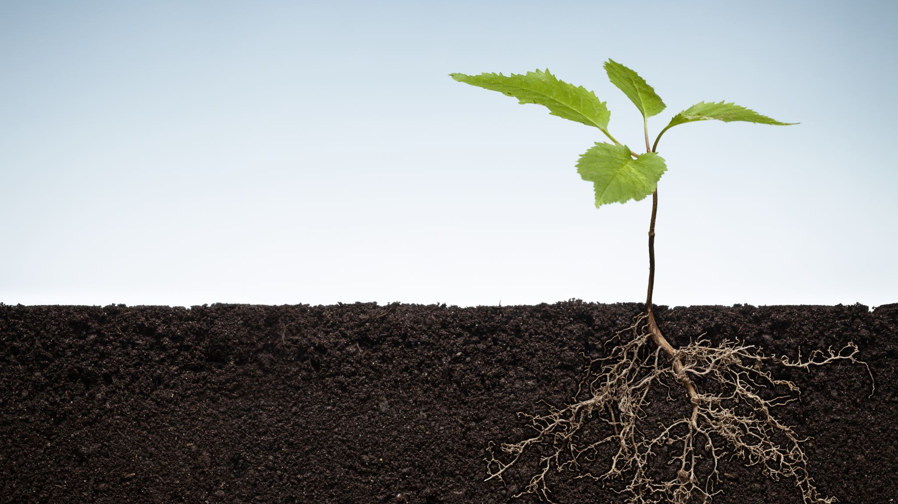
AI-POWERED PLANT DISEASE PREDICTION SYSTEM
BY-
IOMP BATCH-IT 25-02 GUIDE:-
VEDANT MALPANI(22261A1262) DR. M. RUDRA KUMAR
PRITEESH REDDY(22261A1245)

Slide 3
OUTLINE
ABSTRACT
INTRODUCTION
EXISTING SYSTEM
PROPOSED SYSTEM
APPLICATIONS
REQUIREMENTS
LITERATURE SURVERY
PROBLEM STATEMENT
OBJECTIVES
MODULES DESCRIPTION
ALGORITHM
DESIGN ARCHITECTURE&UML DIAGRAMS
TEST CASES
RESULTS
FUTURE ENHANCEMENTS
REFERENCES

Slide 4
ABSTRACT
The health of crops is vital for ensuring a stable and productive farming ecosystem, but diseases can spread quickly, causing significant crop damage and financial loss. Detecting and diagnosing plant diseases early is a challenging yet crucial task for farmers. This project aims to develop an AI-powered Plant Disease Prediction System that uses advanced machine learning and image processing techniques to predict potential plant diseases before they spread, allowing farmers to take timely action.
By leveraging AI algorithms and a robust dataset of plant images, the system analyzes plant health by identifying early signs of disease through visual patterns such as discoloration, spots, and deformations. Using Convolutional Neural Networks (CNNs), the system not only detects visible symptoms but also predicts the likelihood of disease progression based on environmental factors like temperature, humidity, and soil conditions.
Farmers will be able to upload images of their crops through a user-friendly web application, where the system will predict possible diseases, assess the severity, and offer recommendations for preventative measures or treatments. This proactive approach helps farmers minimize the impact of plant diseases, reduce pesticide use, and optimize crop yields. The farmer will receive the message in his/her own mother tongue through any messaging app or through the user-friendly web application.
With this AI-powered prediction system, farmers can work smarter, not harder, by staying ahead of potential outbreaks, ensuring healthier crops, increasing their profits and contributing to more sustainable farming practices.

Slide 5
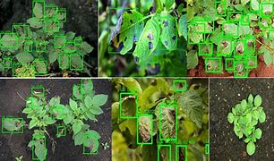
INTRODUCTION
Plants display a variety of physical changes to pathogens which are known as ‘symptoms’ of that particular disease.
Most of the diseases are characteristic symptoms which are visible on the plants. So, while nurturing them, it can be identified.
But, looking at each affected plant can lead to inefficiency. So, it is needed to integrate the agriculture with technology.
With the help of ML algorithms, we can integrate and develop a system to detect and prevent the diseases.
The model will help the farmers to identify the affected part and then it helps them to take precautions.

Slide 6
There are around 38 types of different diseases which are present such as
Apple Black rot’
Apple scab
Apple Cedar rust
Apple healthy
Blueberry healthy
Cherry healthy
Cherry Powdery mildew
Corn (maize)Cercospora leaf spot Gray leaf spot
Corn (maize)Common rust
Corn (maize) healthy
Corn (maize) Northern Leaf Blight
Grape Black rot
Grape Esca (Black Measles)
Grape healthy
Grape Leaf blight (Isariopsis Leaf Spot'

Slide 7
Orange Haunglongbing (Citrus_greening)
Peach Bacterial spot
Peach healthy
Pepper bell Bacterial spot,
Pepper bell healthy
Potato Early blight
Potato healthy
Potato Late blight
Raspberry healthy
Soybean healthy
Squash Powdery mildew
Strawberry healthy
Strawberry Leaf scorch
Tomato Bacterial spot
Tomato Early blight
Tomato healthy

Slide 8
Tomato Late blight
Tomato Leaf Mold
Tomato Septoria leaf spot
Tomato Spider mites Two-spotted_spider_mite
Tomato Target_Spot
Tomato mosaic virus
Tomato Yellow Leaf Curl Virus

Slide 9
EXISITING SYSTEM
1. Plantix (by PEAT GmbH)
Uses smartphone photos to detect plant diseases, nutrient deficiencies, and pests.
Tech: Image-based AI models.
Limitations:
Not fully multilingual (supports only a few major languages).
Often needs stable internet connection.
Limited feedback to farmers.
2. AgroDoctor
Offers a database of plant diseases and treatment recommendations.
Tech: Primarily database-driven, not deep learning.
Limitations:
Not real-time.
No AI-based image detection.
3. CropIn (SmartFarm platform)
End-to-end farm management platform with disease alerts.
Tech: AI + satellite imagery + IoT integration.
Limitations:
Requires enterprise-level setup.
Not designed for individual small farmers.

Slide 10
PROPOSED SYSTEM
The proposed system is an AI-powered solution designed to detect crop diseases from images submitted by farmers through a web interface. Using a trained CNN model, the system processes the uploaded crop images, analyzes the visual features, and classifies them into predefined disease categories.
The proposed system unique because of its integration of multilingual support. After detecting the disease, the system generates a detailed report that includes the disease name, confidence score, symptoms, and recommended treatment measures. This report is automatically translated into the farmer’s preferred language using a translation API like twilio, ensuring accessibility for users from diverse linguistic backgrounds.

Slide 11
APPLICATIONS
1. On-Field Crop Health Monitoring
2. Real-Time Alerts & Notifications
3. Live Dashboard for Agricultural Officers
4. Multilingual Agricultural Helpline
5. Real-Time Data for Crop Insurance

Slide 12
HARDWARE AND SOFTWARE SPECIFICATIONS:
Software Specifications :
Python libraries like sklearn, tensorflow etc.
Front-end tools like html, css and javascript.
Backend tools like flask, Django etc.
IDE environment like google colab.
Dataset for the project is PlantVillage dataset
API like twilio API.
Hardware Specifications
Intel i5 processor
RAM of size 16GB and storage of 512 GB.

Slide 13
LITERATURE SURVEY
S. No | Author Names, Year | Journal / Conference Name & Publisher | Methodology / Algorithms Used | Merits | Demerits | Research Gaps
1 | Javidan et al., 2024 | Elsevier – Smart Agricultural Technology | Feature Engineering, ML classifiers, Image Segmentation | Efficient feature extraction improves disease classification accuracy | Deep learning requires large annotated datasets | Need for more robust feature selection and hybrid approaches for small datasets
2 | Balafas et al., 2023 | IEEE Access | CNNs (ResNet50, MobileNetV2), YOLOv5 | YOLOv5 best for object detection; ResNet50 balances speed and accuracy | Models fail in noisy, real-world conditions | Lack of robust models for uncontrolled environments; need for real-time lightweight models
3 | Tirkey et al., 2023 | Elsevier – Smart Agricultural Technology | YOLOv5, InceptionV3, CNN with transfer learning | YOLOv5 offers 98.75% accuracy and real-time performance (53 fps) | Focused only on soybean, lacks generalizability | Require extension to multiple crops and multi-class disease detection
4 | Dolatabadian et al., 2024 | Wiley – Plant Pathology | CNN, RNN, UAV-based imaging, ML fusion models | Integration of contextual data improves detection reliability | High implementation cost with advanced sensors | Limited real-world deployment and field validation; lack of integrated IoT-based disease response
5 | Mishra et al., 2023 | Elsevier – Alexandria Engineering Journal | Customized CNN with IoT sensors, Raspberry Pi | 98.8% accuracy; scalable; real-time alerts for millet diseases | Disease focus limited to rust and blast in millet | Expandability to other crops and disease types; enhancement of cross-platform

Slide 14
PROBLEM STATEMENT
In addition to breaking the language barrier, the system also aims to solve the problem of delayed and inaccurate crop disease identification. Traditional methods require manual inspection or expert consultation, which can be slow, inconsistent, and not always available to small-scale farmers. The proposed solution leverages computer vision and deep learning, particularly CNN, to detect plant diseases from images submitted by the farmers. It provides real-time results with high accuracy, reducing the risk of disease spread and helping farmers take immediate action to protect their crops and minimize yield loss.
In many rural and regional farming communities, language remains one of the biggest barriers when accessing agricultural technology. Most existing crop advisory or disease detection systems provide their output only in English or a limited set of languages, making them difficult to understand and act upon for farmers who primarily speak local or regional dialects. To overcome this challenge, the proposed system is designed with built-in multilingual support. It allows farmers to receive crop disease reports, preventive suggestions, and treatment recommendations in their native language, making the solution more inclusive and user-friendly. By integrating automatic translation through APIs or pre-trained models, the system ensures that the communication between AI and farmer is clear, accessible, and actionable.

Slide 15
OBJECTIVES
To develop an AI-based system capable of accurately detecting crop diseases from images using machine learning techniques.
To support multilingual output, enabling farmers to receive disease diagnosis and treatment guidance in their native languages.

Slide 16
MODULES
The modules of this project are:
1. Image Preprocessing Module
Enhances uploaded crop images to improve detection accuracy.
Performs:
Resizing and normalization
Background noise reduction
2. Disease Detection Module
Uses Machine Learning / Deep Learning models (like CNN) to analyze the image.
Compares features with a trained dataset of healthy and diseased crop images.

Slide 17
3. Multilingual Translation and Report generation Module
Converts diagnosis and treatment recommendations into the user’s selected regional language .
Generates the report based on the output in that particular language.
Uses translation library like googletrans.
4. Notification & Recommendation Module
Sends instant alerts and crop care suggestions via: SMS, App notification and email with the help of twilio API.

Slide 18
ALGORITHM
In this project, we are using CNN( Convolutional Neural Network) algorithm. CNNs are highly effective for image classification tasks, especially in plant disease detection, where visual patterns like spots, color changes, or distortions indicate different diseases.
There are various architectures present in CNN which are used but we are using MobileNetV2.
MobileNetV2, a CNN architecture pre-trained on ImageNet, and fine-tune it for our specific plant disease dataset. It is chosen for its:
Lightweight design suitable for deployment on mobile/web apps
Efficient computation using depth wise separable convolutions
Inverted residuals and linear bottlenecks that improve performance while reducing complexity
There are three layers used in CNN:
Input layer: The input layer is the first layer which takes images as input and does normalization and resizing is applied. Then, it is feeded to the next layers.
Hidden Layer: This is where all the "learning" happens. We use MobileNetV2 base as feature extractor. It consists of multiple separable convolutional layers like inverted residual blocks and linear bottlenecks. These layers extract rich visual features like textures, shapes and color patterns. The hidden layers used in this system are
1. Depthwise Separable Convolutions: Applies a single filter per input channel.
2. Inverted Residual Blocks: It is a narrow input layer which is used to expand the convolution into higher dimension.

Slide 19
3. Global Average Pooling (GAP): Instead of flattening a large feature map, GAP compresses each feature map to a single value. It reduces overfitting, eliminates fully connected layers, makes the model more robust.
4. Fully Connected (Dense) Layer: This is a classic neural layer where each neuron connects to all outputs from the GAP layer. Learns abstract features like disease type, intensity, and patterns based on extracted image features
3. Output Layer:
Number of Neurons: Equal to the number of classes we are predicting For example, if we have 6 categories (like healthy and diseased states of 3 crops), then we have Dense(6)
Activation Function: Softmax
Layer Type: Dense (Fully Connected)
The Softmax activation function converts raw output scores (logits) into probabilities.
Each output value lies between 0 and 1, and the sum of all output values equals 1.
This helps the model decide which class the image most likely belongs to.

Slide 20
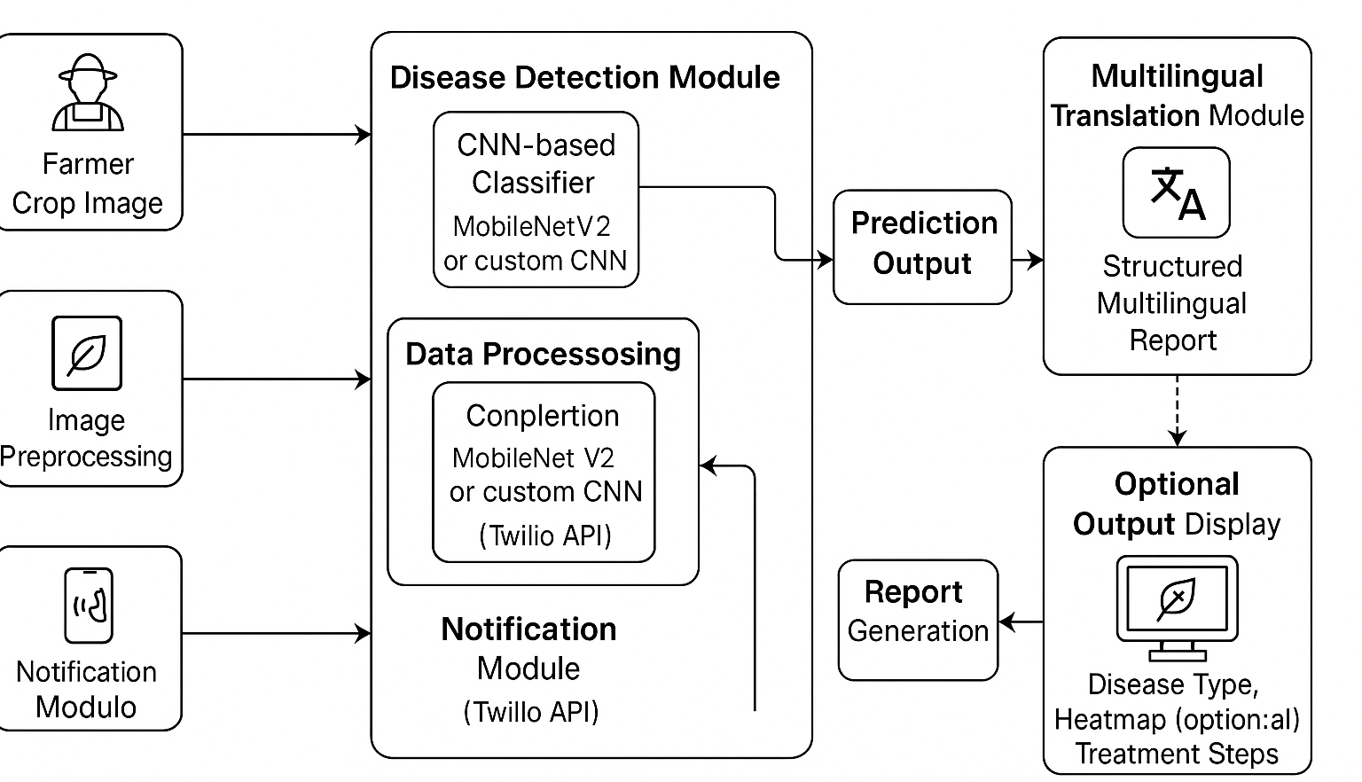
DESIGN ARCHITECTURE
Fig 1: Design Architecture of Plant disease Prediction System.

Slide 21
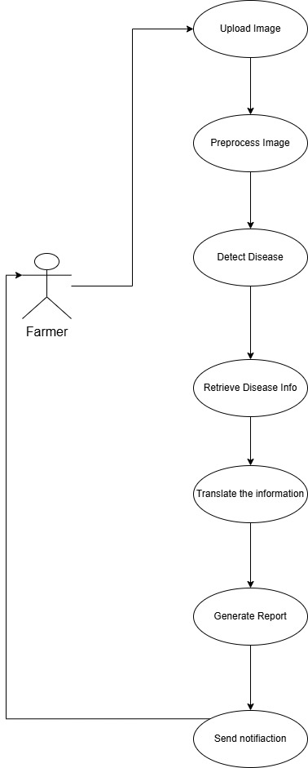
USE-CASE DIAGRAM

Slide 22
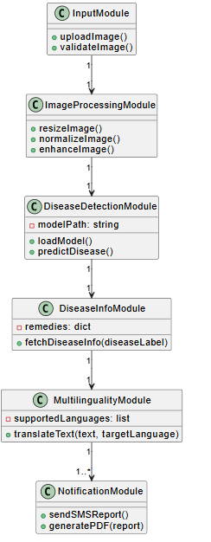
CLASS DIAGRAM

Slide 23
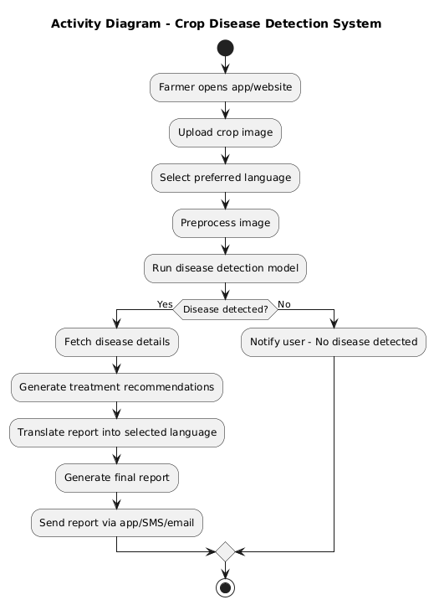
ACTIVITY DIAGRAM

Slide 24
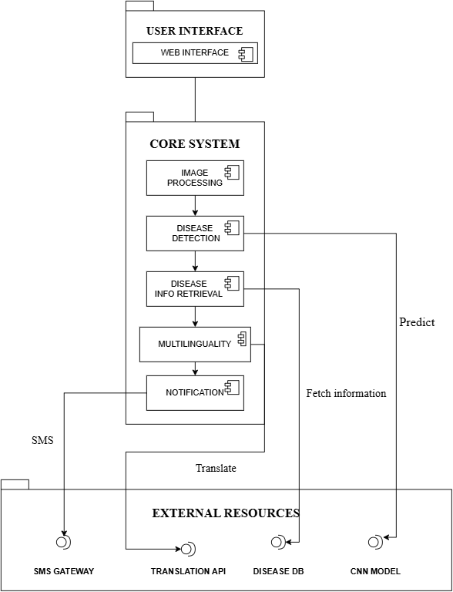
COMPONENT DIAGRAM

Slide 25
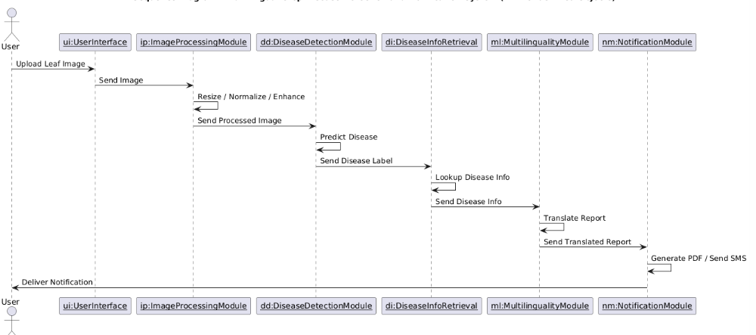
SEQUENCE DIAGRAM

Slide 26
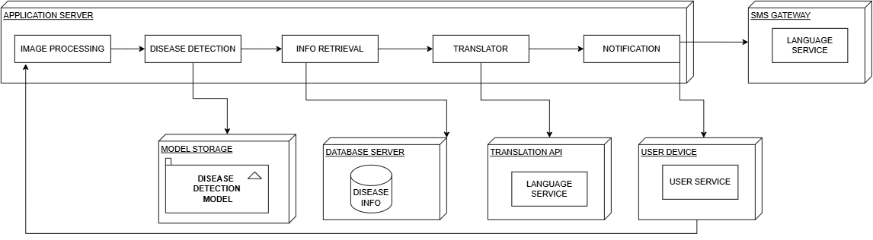
DEPLOYEMENT DIAGRAM

Slide 27
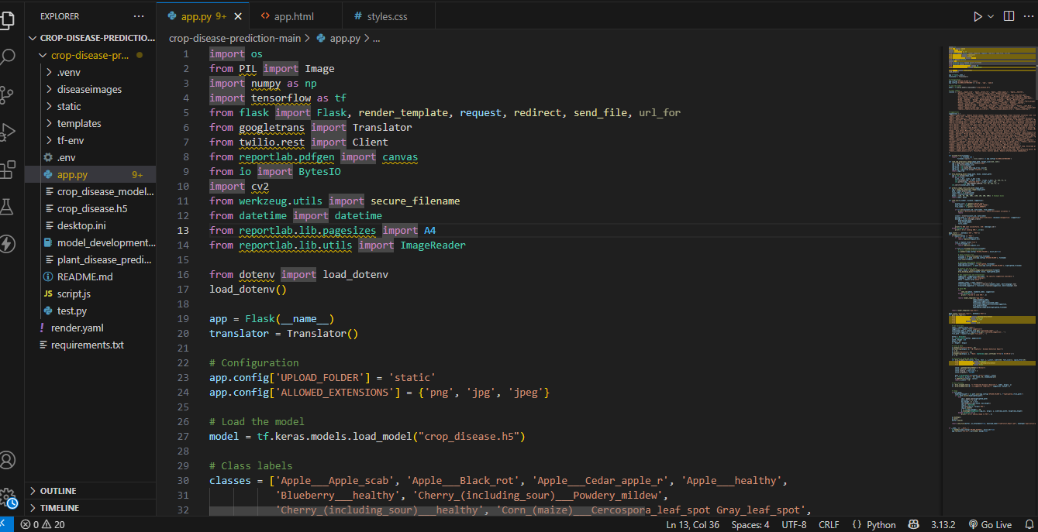
CODE IMPLEMENTATION

Slide 28
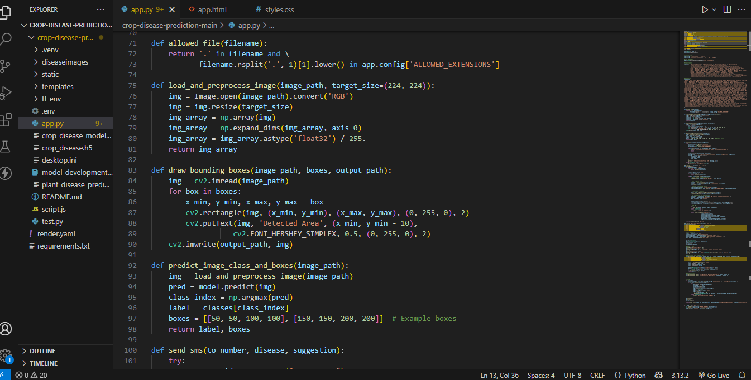

Slide 29
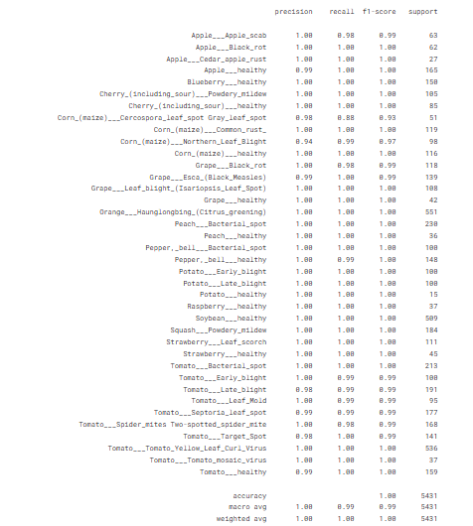
PERFORMANCE ANALYSIS
Fig 1: Performance metrics like precision, recall, f1-score.

Slide 30
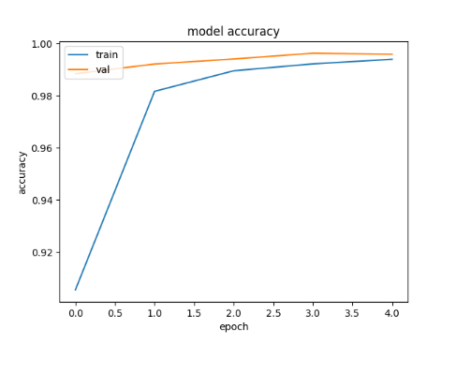
Fig 2: The figure shows the model accuracy during training phase and validation phase

Slide 31
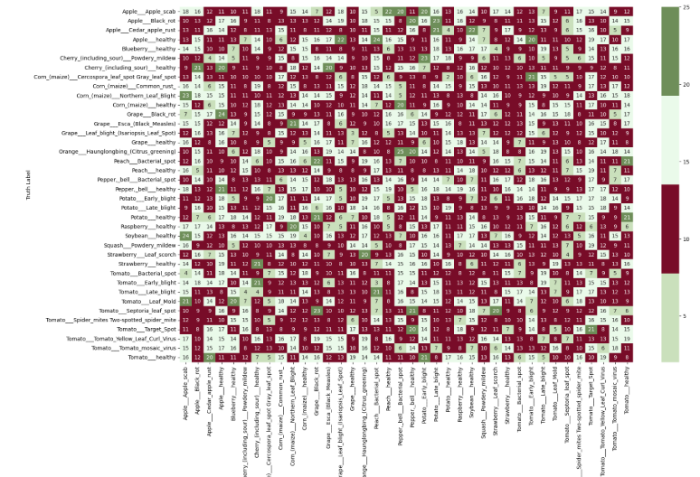
Fig 3: Confusion matrix for the plant disease prediction system where all the 38 diseases are taken into consideration

Slide 32
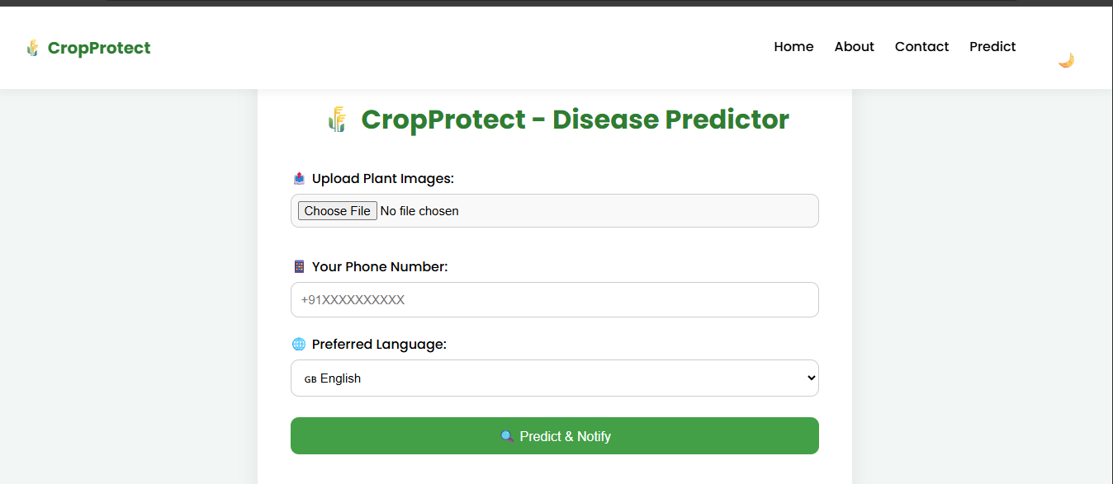
RESULTS
Fig 1: Home page where the user can upload the leaf image with phone number and preferred language

Slide 33
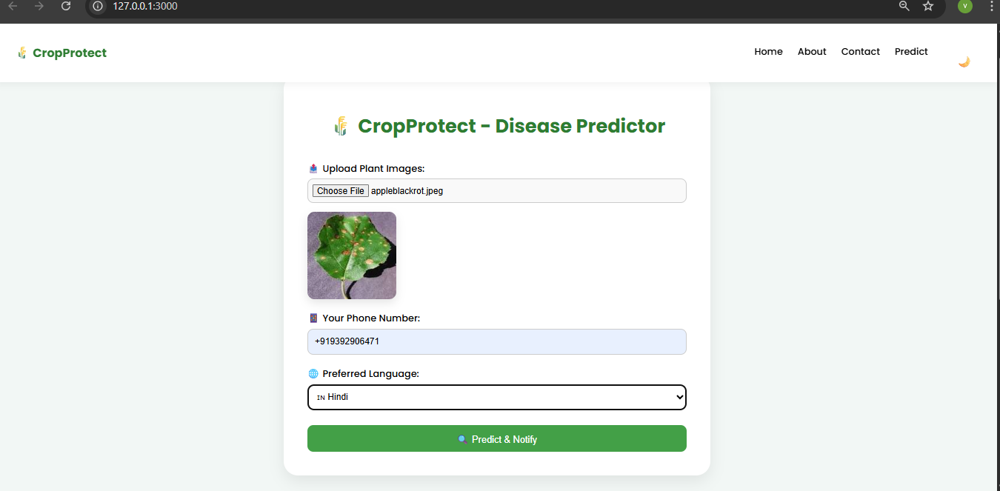
Fig 2: Image uploaded page where the image which the user has given is shown with the mobile number and preferred language.

Slide 34
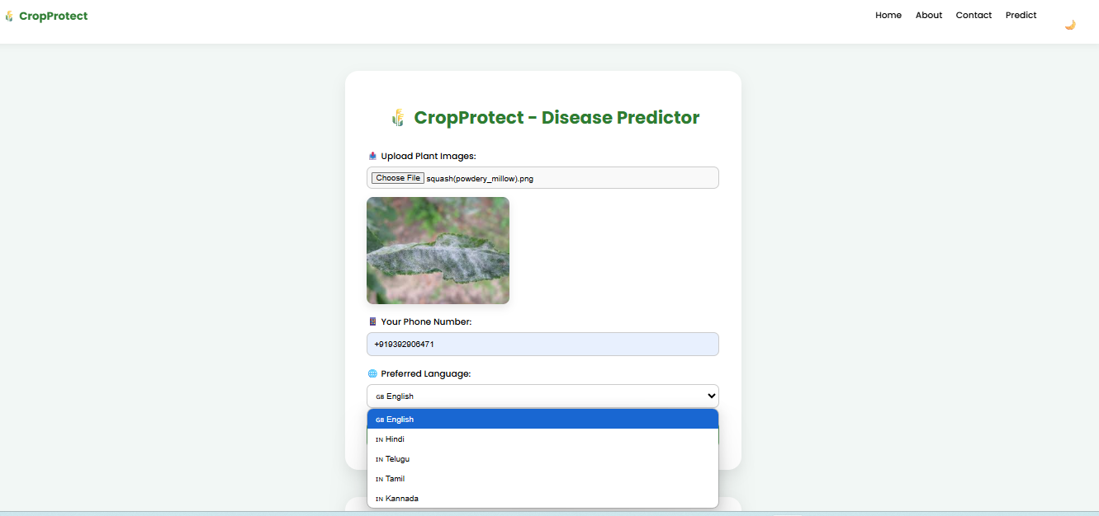
Fig 3: Drop-down menu of preferred languages

Slide 35
https://drive.google.com/file/d/15uG71xt8XECEyvMkeEfEItlpxUIesZVb/view?usp=drive_link

Slide 36
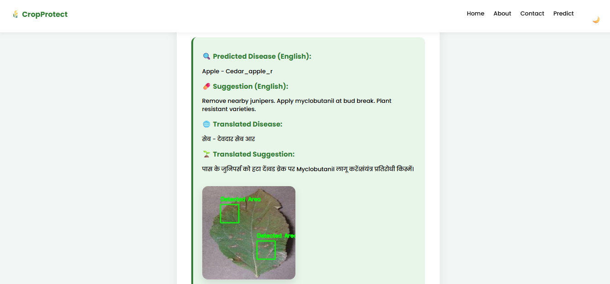
Fig 4: Output page where the crop disease is predicted and it is shown with the highlighted part

Slide 37
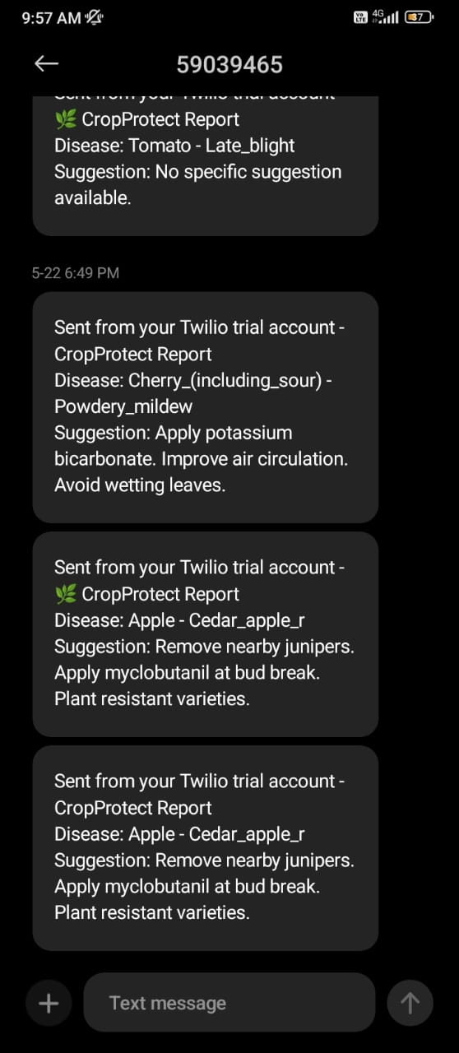
Fig 5: Notification sent to the registered mobile number

Slide 38
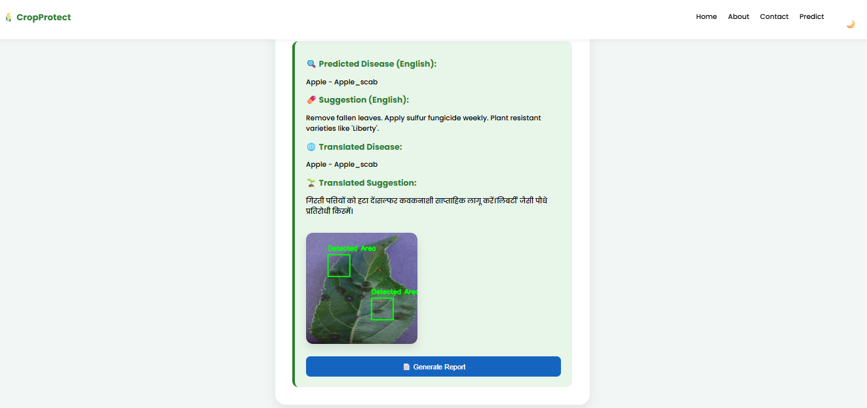
Fig 6: Report is generated by clicking on the “generate report” .

Slide 39
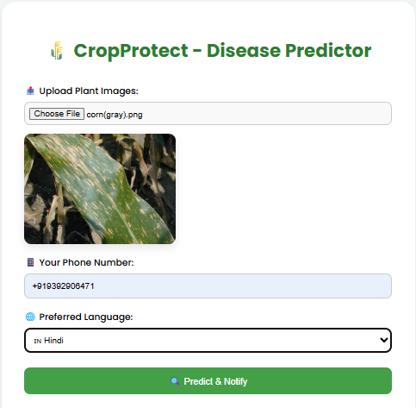
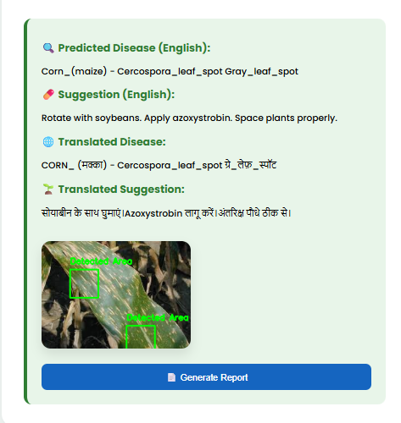
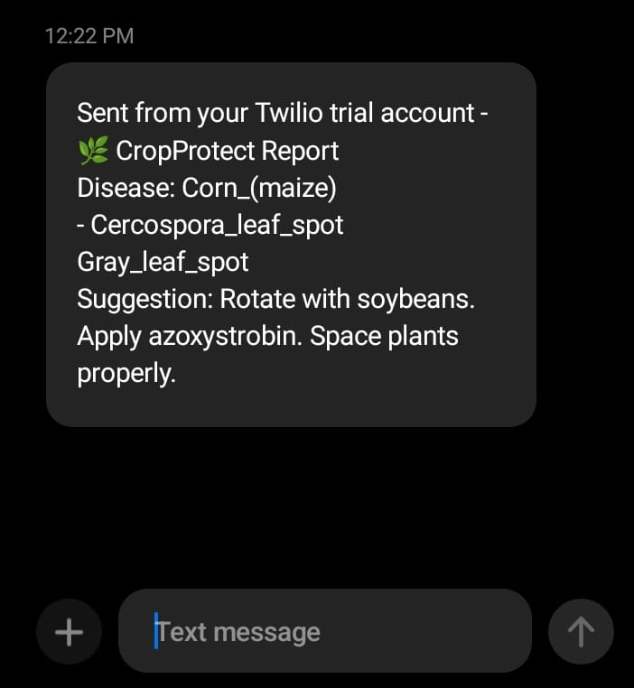
Fig 7: Prediction of corn (gray) leaf spot disease

Slide 40
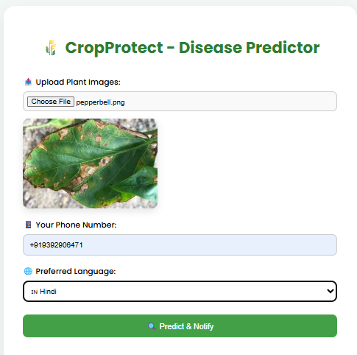
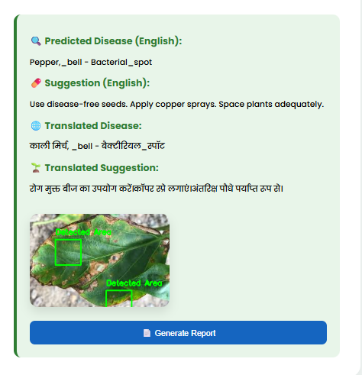
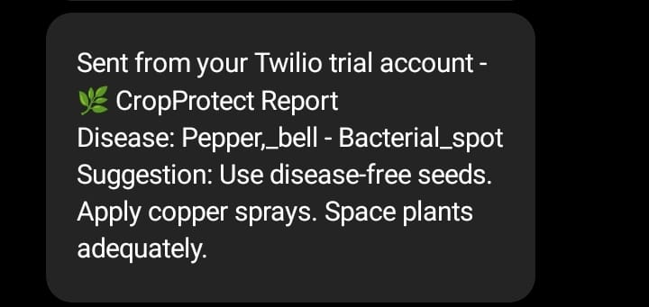
Fig 8: Prediction of pepper_bell_bacterial_spot disease

Slide 41
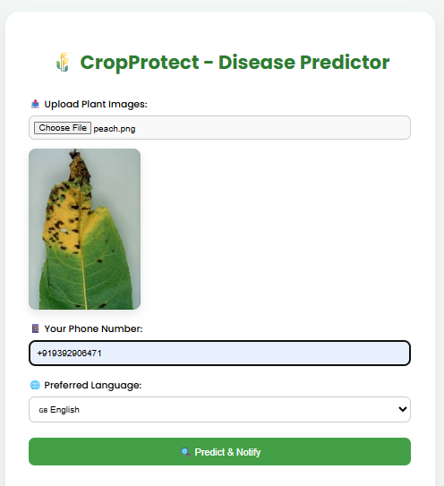
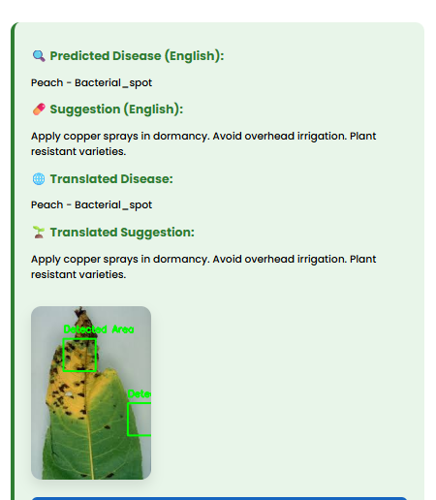
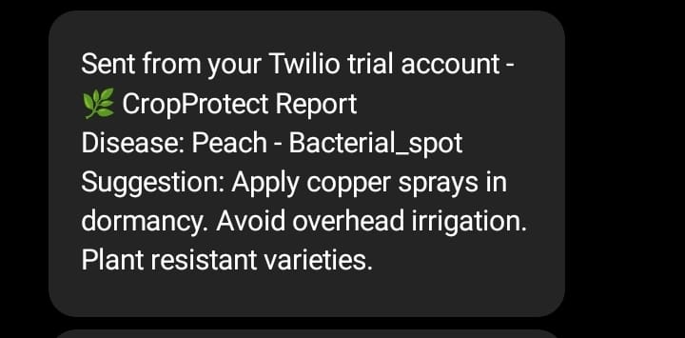
Fig 9: Prediction of peach bacterial_spot disease

Slide 42
CONCLUSION
The CropProtect system successfully integrates AI-based plant disease detection which provide different services to the farmers like SMS alerts for real-time field communication, PDF report generation for record-keeping as well as multilingual support to improve farmer accessibility. It provides an end-to-end solution from image upload to actionable diagnosis, enabling early detection and intervention. The system improves accuracy, transparency, and farmer outreach, making it practical for both local and large-scale agricultural applications.

Slide 43
FUTURE ENHANCEMENTS
Add IoT-based monitoring (e.g. sensors for temperature, humidity, soil moisture).
Launch a mobile app with camera support for field use.
Use GPS + weather data to give location-based crop tips.
Add voice assistant in regional languages.

Slide 44
TEST CASES
Test Case ID | Test Case Name | Test Description | Expected Output | Actual Output | Remark
TC_01 | Healthy Leaf Detection | Upload a healthy leaf image (e.g., Tomato_healthy.jpg) | Label displayed: “Tomato – healthy” | Leaf shown as healthy | Success
TC_02 | Unhealthy Leaf Detection | Upload a diseased leaf image (e.g., Potato_Early_blight.jpg) | Disease name detected and displayed | Disease shown on dashboard | Success
TC_03 | SMS Notification | Enter user phone number after detection | SMS delivered with disease name and suggestions | SMS delivered successfully | Success
TC_04 | PDF Report Generation | Click “Generate Report” after detection | PDF generated with image and disease information | PDF generated correctly | Success
TC_05 | Multilingual Translation | Select any target language (e.g., Hindi) for output | Information translated into selected language | Report shown in that language | Success

Slide 45
REFERNECES
[1] Seyed Mohamad Javidan, Ahmad Banakar, Kamran Rahnama, Keyvan Asefpour Vakilian, Yiannis Ampatzidis,Feature engineering to identify plant diseases using image processing and artificial intelligence: A comprehensive review, Smart Agricultural Technology, Volume 8, 2024, 100480,ISSN 2772-3755, https://doi.org/10.1016/j.atech.2024.100480.
[2] Divyanshu Tirkey, Kshitiz Kumar Singh, Shrivishal Tripathi, Performance analysis of AI-based solutions for cropdisease identification, detection, and classification, Smart Agricultural Technology, Volume 5, 2023, 100238, ISSN 2772-3755, https://doi.org/10.1016/j.atech.2023.100238.
[3] Sushruta Mishra, Dayal Rohan Volety, Navdeep Bohra, Sultan Alfarhood, Mejdl Safran, A smart and sustainable framework for millet crop monitoring equipped with disease detection using enhanced predictive intelligence, Alexandria Engineering Journal, Volume 83, 2023, Pages 298 306, ISSN 1110-0168, https://doi.org/10.1016/j.aej.2023.10.041.
[4] V. Balafas, E. Karantoumanis, M. Louta and N. Ploskas, "Machine Learning and Deep Learning for Plant Disease Classification and Detection," in IEEE Access, vol. 11, pp. 114352-114377, 2023, doi: 10.1109/ACCESS.2023.3324722.
[5] Dolatabadian A, Neik TX, Danilevicz MF, Upadhyaya SR, Batley J, Edwards D. Image‐based crop disease detection using machine learning. Plant Pathology. 2025 Jan;74(1):18-38

Slide 46
[6] Plantix by PEAT GmbH. A smartphone-based app using AI for plant disease, pest, and nutrient
deficiency detection. Available: https://plantix.net/en/ (Accessed April 2025).
[7] AgroDoctor. A database-driven plant disease diagnosis and treatment platform.
Not AI-based or real-time. Available: https://www.agrodoctor.eu/ (Accessed April 2025).
[8] CropIn - SmartFarm Platform. AI-powered farm management and disease alert system integrating
IoT and satellite imagery. Available: https://www.cropin.com/solutions/smartfarm (Accessed April 2025).

Slide 47
THANK YOU !!

